Slide 1
Digital Marketing Internal Assessment
Analyzing Present Offerings Mix

Slide 2
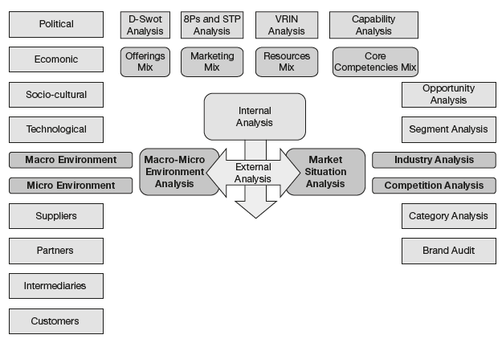

Slide 3
SWOT (Strengths, Weaknesses, Opportunities, and Threats)
8P - product; price; place; promotion; people; process; physical evidence; and productivity.
STP (segmentation, targeting and positioning)
VRIN (Valuable, Rare, Inimitable and Non- Substituable)

Slide 4
Offerings and Marketing Mix
Products are virtual in the digital world
Nature of target audience differs
Brand switching is quite high
Digital requires different communication elements
Products in control of intermediaries/aggregators

Slide 5
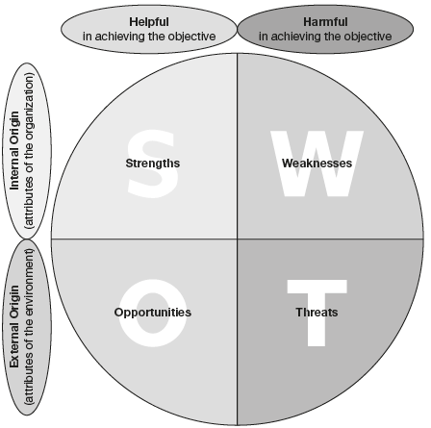
Understanding D-SWOT Analysis

Slide 6
The key elements of the D-SWOT model include:
Strengths
Weaknesses
Opportunities
Threats

Slide 7
Marketing Mix Analysis
Product
Price
Place
Promotion
People
Process
Programs
Performance

Slide 8
Internal Resource Mapping
Input-driven resources: materials, energy, natural resources
Economic resources: land, capital, infrastructure
Human resources: employees, contractors, third parties
Technology resources: information, communication, storage systems
Intellectual resources: brand capital, intellectual property, patents, and trademarks
Partner/intermediary resources

Slide 9
Core Competencies Analysis
There are three tests to identify core competencies of a firm
Relevance
Difficulty of imitation
Breadth of application

Slide 10
For Google, here are some of the key core competencies
Search accuracy
Design simplicity
Querying speed
Aesthetic branding
Guided navigation concept
Free of cost services

Slide 11
Let us look at some of their evident core competencies for APPLE
Product innovation
User experience
Technology competence
Brand marketing
Premium positioning

